Slide 1

DEV A Banking Virtual Assistant

Slide 2
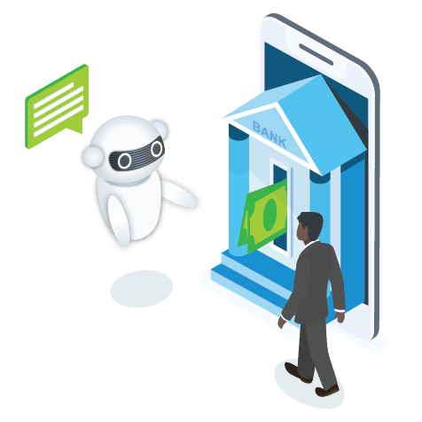
DEV BANKING ASSISTANT
FROM ‘SUFFICIENCY’ TO ‘EFFICIENCY’
The virtual financial assistant Dev is designed to help customers more easily manage their money. Within the interactive interface, Dev converse to answer FAQs, provide reward and account balances, spending summaries, refund confirmations and credit scores. He can also identify duplicate charges and send bill reminders.
Dev will be designed for the customers to :
*More easily manage their money.
*Check on a loan status.
*Facilitating payments with mail alert.
*Getting instant answers to FAQs.
Key Features of the Product :
* Instant Response with automatic time-to-time pop-ups (alerts).
*Proactively reaches out if a bill is higher than normal and send bill reminders.
* Identifies duplicate charges, Suspects fraud and sends mail alert.
*Provides reward and account balances, spending summaries, refund confirmations and credit scores
7
Notes:
Food loss and waste reduction should be seen as a means toward achieving other objectives, including improving food security and nutrition, reducing greenhouse gas emissions, lowering pressure on water and land resources and can increase productivity and economic growth. The formulation of effective policies toward food loss and waste reduction requires comprehensive information as to how much and where – both geographically and along the supply chain – various foods are lost or wasted. FAO’s work on measurement and support to countries to take action to reduce food loss and waste is critical to tracking progress made by countries..

Slide 3
68%
68% of consumers like chatbots because they provide quick answers
80%
Chatbots are projected to handle 75-90% of banking queries by 2022 (CNBC)

Slide 4
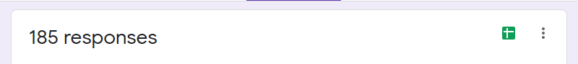
OUR STATs
60% of the customers love to use more interactive way like chatbots.
27% via mobile applications etc.
11% want to go to offline banks.
2% want calls.
AGE – 18 to 30
60%
want to use chatbot

Slide 5

Log In
Log off
DAILY ACTIVITY
Initialize the chat
Rewards
Authenticate
FAQ’S
Cheque
Transactions
Invoice Analyzer
JUST BY DESCRIBINGkl1

Slide 6


OUR VISION
From ‘sufficiency’ to ‘efficiency’
We’ll connect humans to bank.
Dev will be available for the customers to interact 24*7

Slide 7
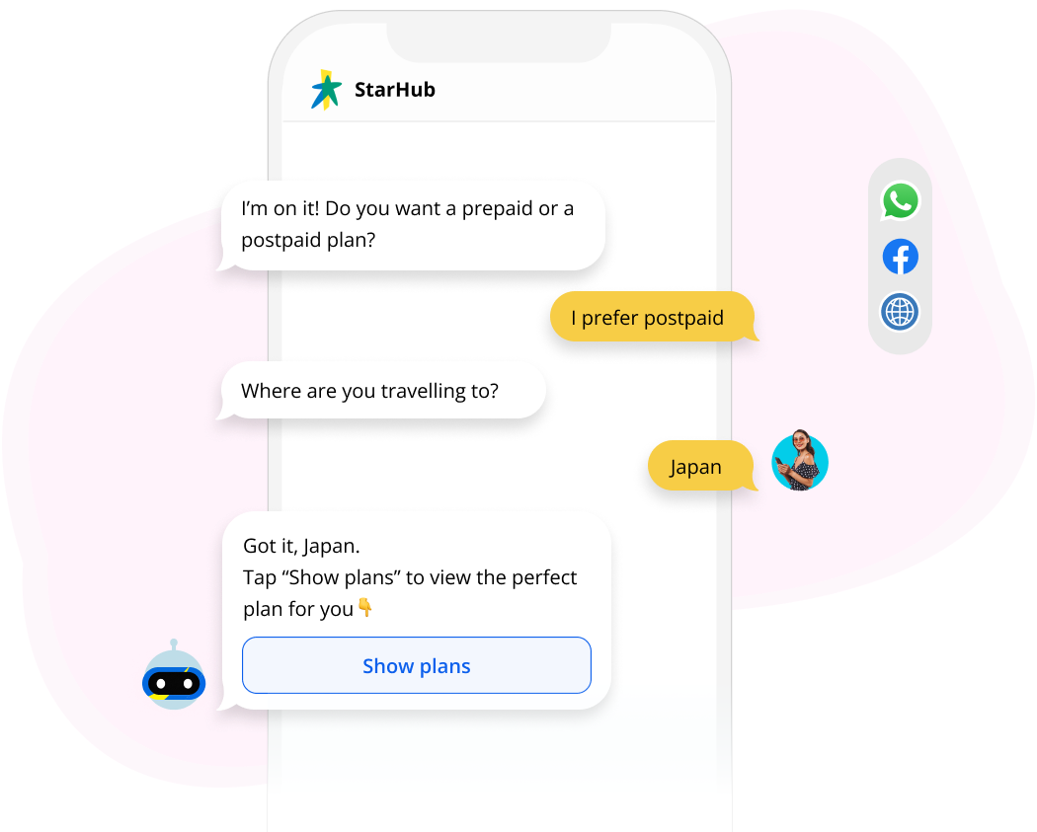
Conversation with DEV
Turn transactions into relationships
DEV
Virtual assistants with voice recognition and personalized insights—not just simple typing and responses to basic inquiries—are the next evolution of AI-powered technology for digital banking and customer service.
I am on it! Do you want to know this months bills?
Yes! pending ones
Mobile Plan is about to expire in a week. Do you want me to show plans
Automate FAQs
Yes!
Help customers check bank balances, find ATMs, check interest rates, and much more. Answer questions about credit or loan applications and get customers the information they need, exactly when they need it.
Got it!
Tap “Show plans” to view the perfect plan for you
Send reminders and notifications
Gives customer peace of mind with reminders about payment deadlines and financial processes. Notify customers about changes in credit scores or relevant news.
Solve urgent issues fast
Offer immediate help when it matters most. Send notifications about suspicious charges and help customers take immediate action.

Slide 8
Step 1
Chat with Dev sharing the details of your Banking Query
Step 3
Incase of a transaction related query, Dev shows the best matched transactions + The alert is sent to users registered mail using Microsoft Power Automate
Step 2
Automated bot Dev will understand your intent using LUIS + Trigger the request with Language Studio QnA Maker to get a response of FAQ.
Step 4
Dev responds with the user understandable language giving a humanly feel

Slide 9
Power Automate
Detect Language
MS Language Resource
LUIS will be used for intent recognition
OTP Sent + Verified
FAQs
MS Language Studio QnA
Cheque Transaction
Initialize
Main Features
Computer Vision
Service Product Record
MS Cosmo DB (NoSQL)
Automatically get’s updated to COSMO DB
Khata Book
MS Power Automate
+ MS Teams
Send Confirmation Mail
Schedule
Teams Meeting
Log Off

Slide 10
Log In
Log off
DAILY ACTIVITY
Initialize the chat
Rewards
Authenticate
FAQ’S
Loan Status
Transaction History
JUST BY DESCRIBING

Slide 11




Microsoft
1.
Techstack Used?
Dev will be built over Microsoft Bot Builder Framework using C# language.
IDE – Visual Studio 2022 (Community Version)
Microsoft Language Studio *LUIS
*Speech Resource
*QnA to answer FAQ’s
Hosting platform Azure, i.e. is the second-largest cloud computing platform serving millions of applications, integrations, and customers.

Slide 12
Microsoft
1.
Azure Services Used?
Azure Language Studio
Language Detection
Language Understanding
Language Translation
Question Answering
Microsoft Azure Cognitive Services
Computer Vision
Form Recognizer
Object Detection
Speech Resource
Sentiment Detection
Azure Static Web App
Azure Bot Service
Azure Cosmo DB
Azure Maps
Microsoft Power Automate
Microsoft Teams
Microsoft Outlook

Slide 13
S
W
Easy to share
2-Factor Authentication
OFFICIALS can easily share the report to the admin Immediately
Hustle Free
Will add microsoft Authenticator.
No Calls, No Extra App To Download
Natural Language
Resource Optimisation
We can train our bot to understand the natural language of the user.
Using Machine Learning model
Scalable
O
Virus / Bugs
Multiple Number of users can be added
T
With exposure over internet,
Tie-Ups
Recurring Cost
Same application can run over different channels Eg. MSTeams,
Wechat, Email …
A small but recurring amount of Funds paid to azure.

Slide 14
YOU HELD THROUGH !
Thank you!
Prepared by:
Mayank Gupta

Slide 15
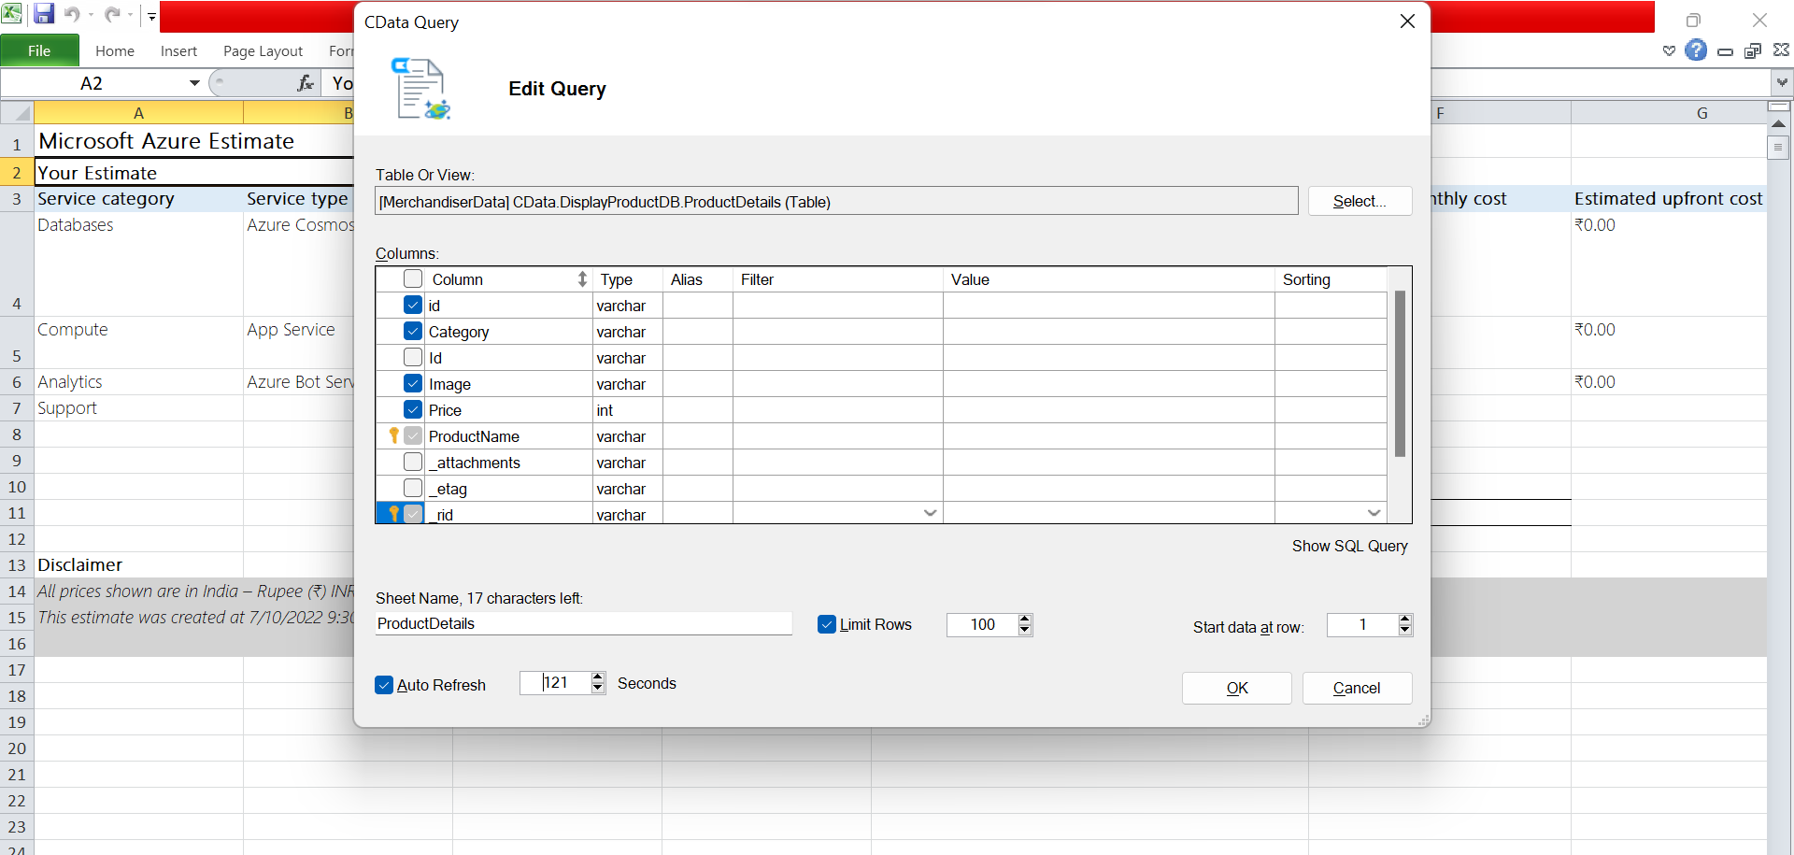

Slide 16
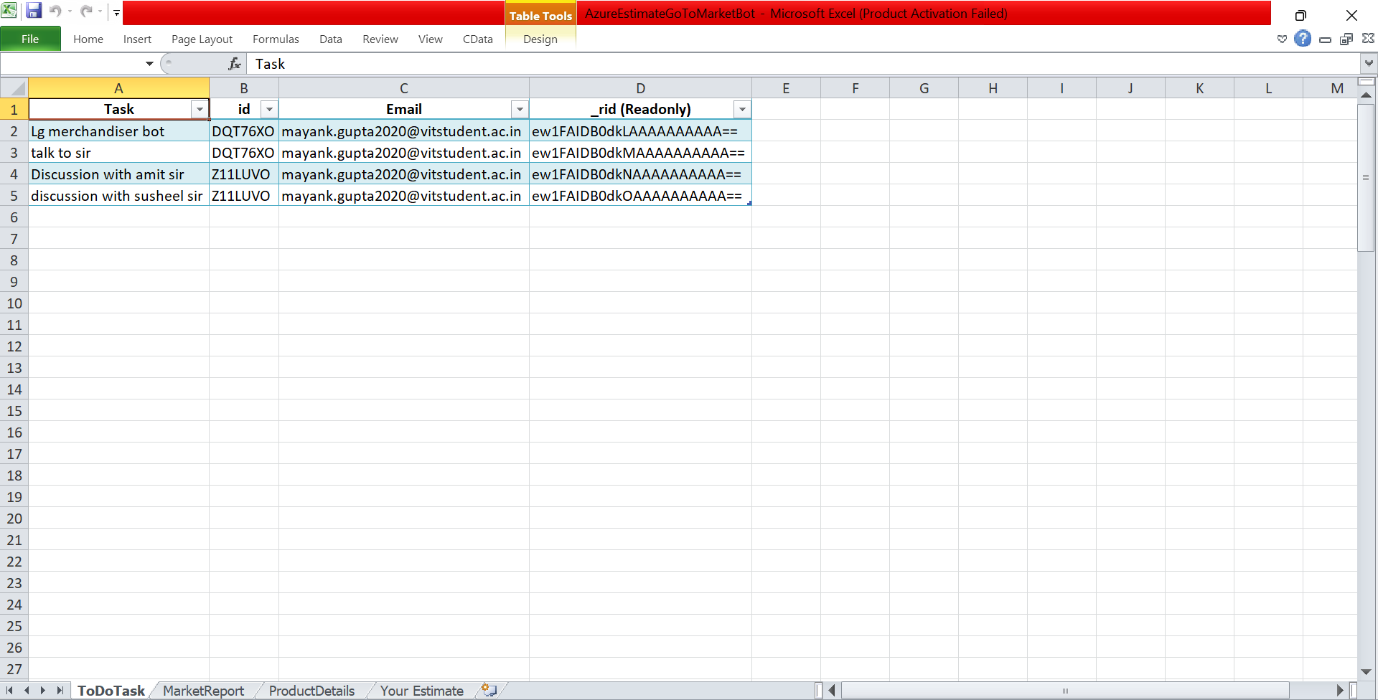
To Do Task Sheet

